Slide 1
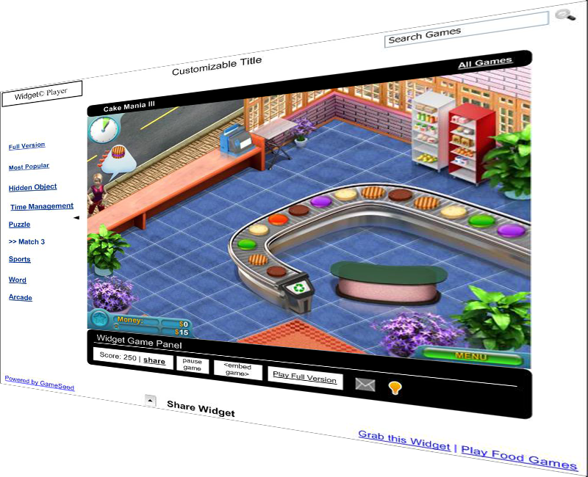
June 2010 Exent Technologies.
The Widget | Design Overview
Exent.com
1
Notes:
1

Slide 2
Overview
The Widget is new game syndication product by Exent Technologies Inc.
It is a Web App that publishers (website owners) will be able to add to their websites.
The Widget will allow users to play free, full version Casual Games on the publisher’s website.
The publishers will be able to earn revenue generated during game usage.
Exent.com
2

Slide 3
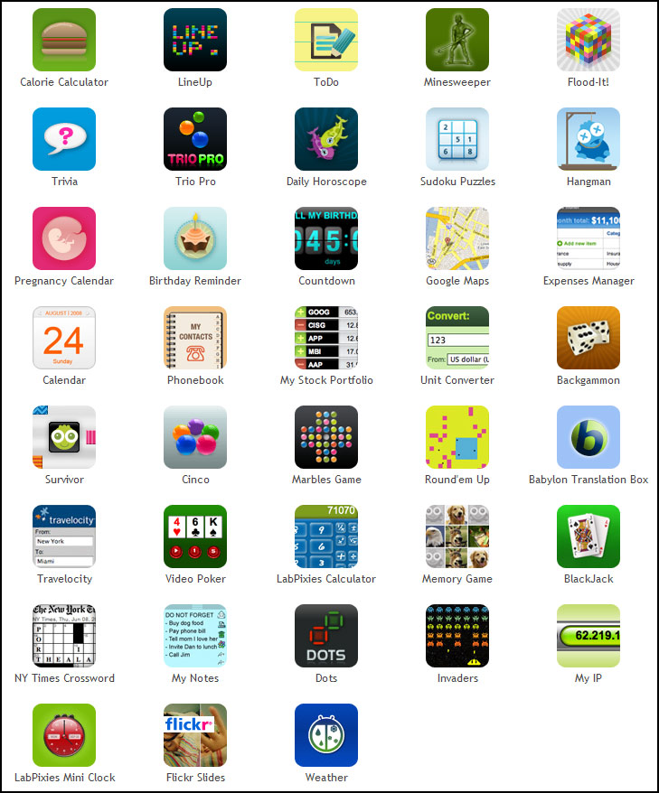
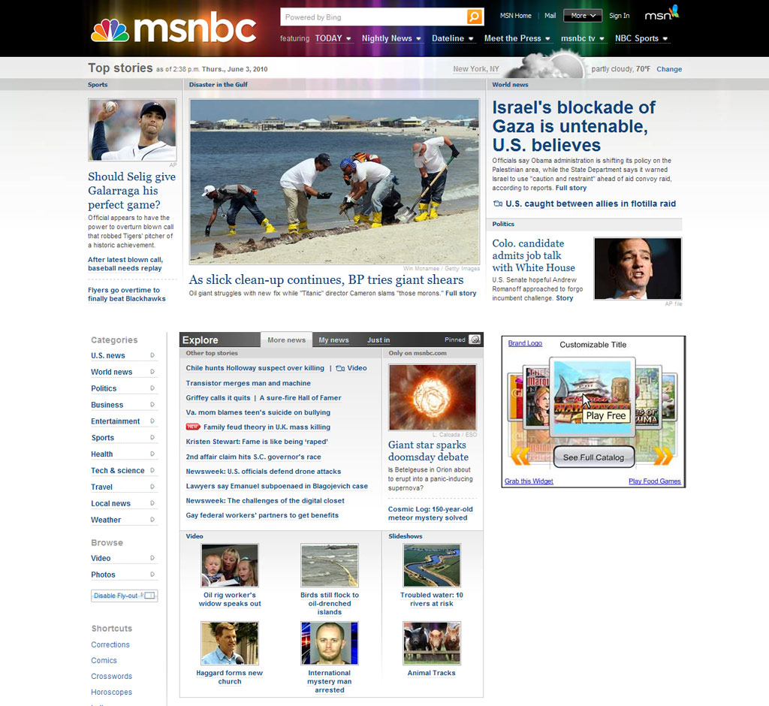
Concept: Game Apps for your site
Publishers can add a variety of Game Apps to their sites.
Cool, Free Apps:
Industry related games (e.g. “Food Games”, “Fashion Games”).
Interchangeable “Game of the Day”.
Game App can be grabbed from Apps Marketplaces.
Exent.com
3

Slide 4
Design Concept – Key Factors
Design must have its unique brand identity. A great example is 5min.com’s “Smart Player”: www.5min.com
The widget is an “App” and its design should look cool, fun and appealing to a wide audience.
The Widget design should be adaptable for various websites with different designs.
Description of average user that plays casual games: Female, +35 years old, with household income below 50K$.
GUI is essential: precise, clean and intuitive.
A Competitor’s Widget example: http://www.heyzap.com/publishers/widgets
Exent.com
4

Slide 5
What do we need?
A unique “Killer” design concept!
Exent.com
5

Slide 6
Design Requirements
Exent.com
6

Slide 7
The Widget Player
Header
Game Area
Widget Panel
Exent.com
7

Slide 8
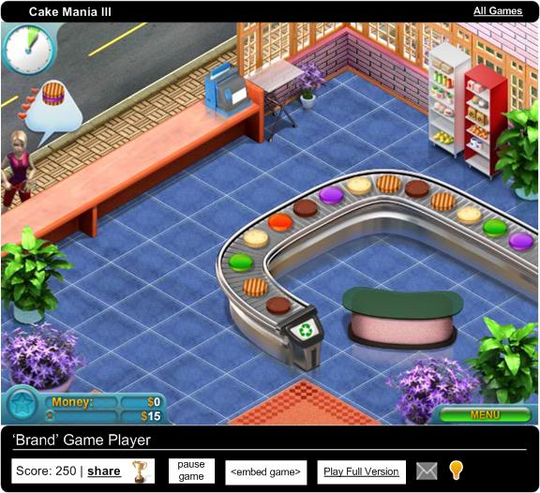
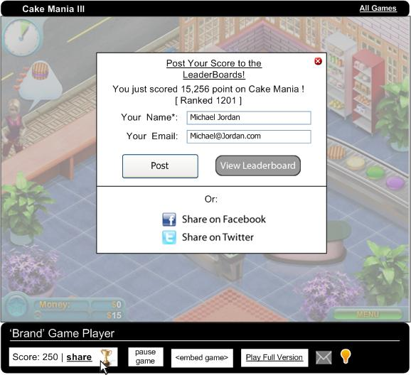
The Widget Player - Panel
…opens a Dialog Window
Clicking on Panel Buttons…
Exent.com
8

Slide 9
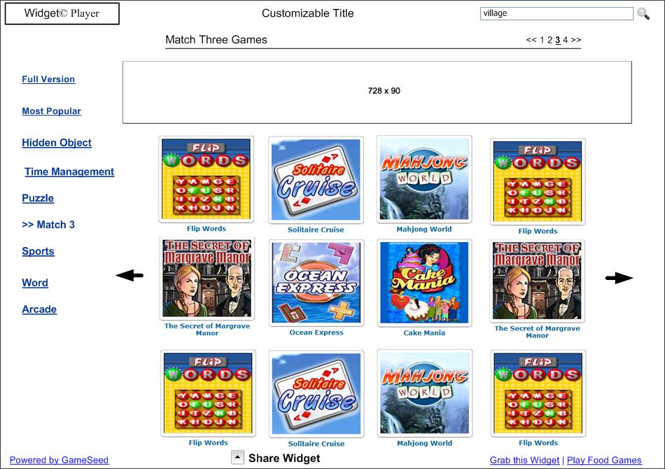
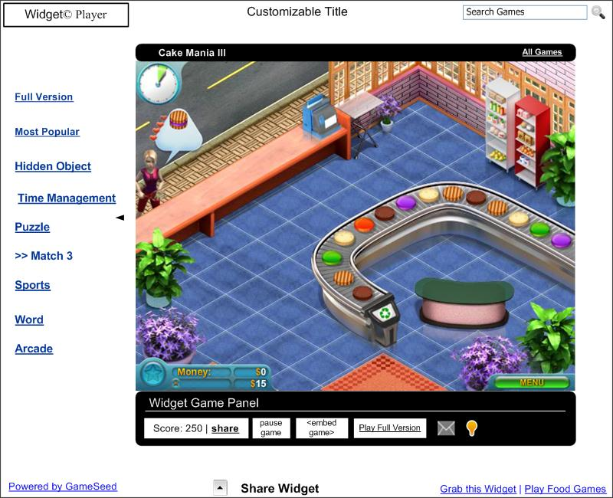
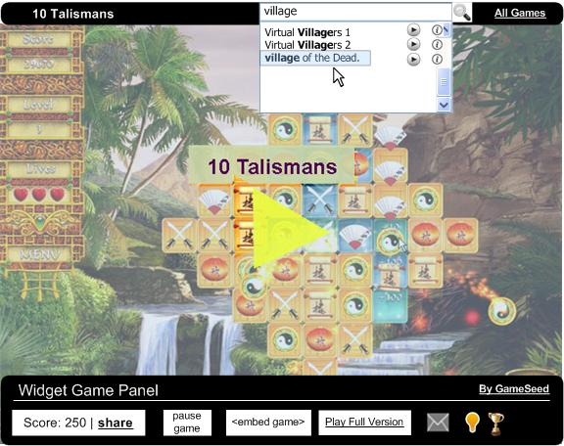
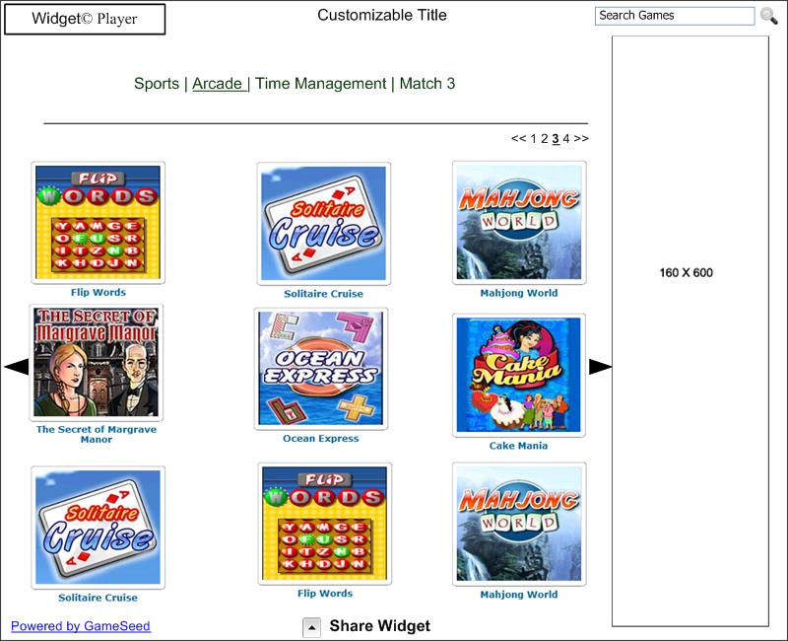
Widget Layouts
Different layout sizes with full game catalog.
Widget Player within a layout.
Single Game Layout
Exent.com
9

Slide 10
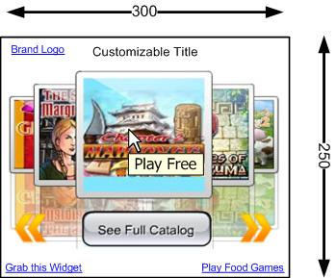
Launchers
Banner Sized Launchers
Exent.com
10

Slide 11
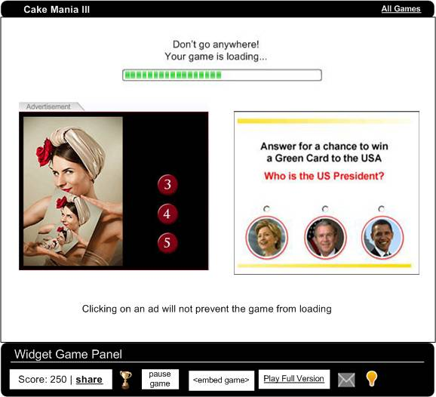
Advertising Units
Different ad units during the games.
Pre Roll
Mid-Roll, Post Roll
Skin Ads
Constant Banners
Exent.com
11

Slide 12
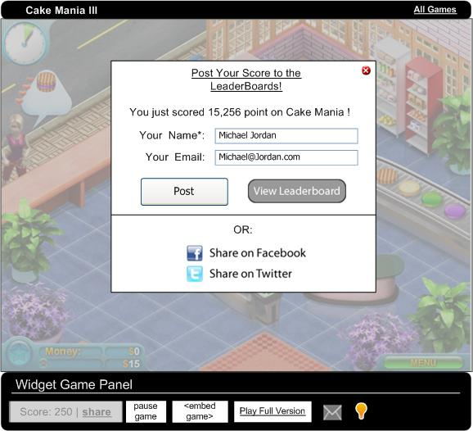
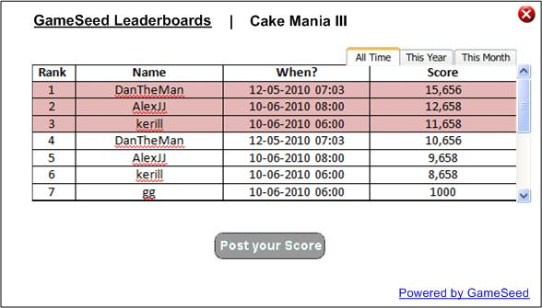
Leader boards
Users can post their score to a leader board
Leader board table with sorting options.
Exent.com
12

Slide 13
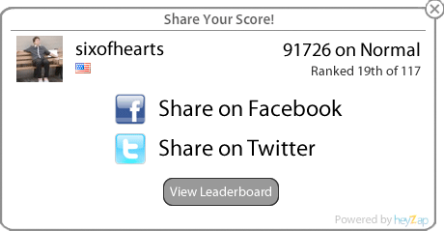
User Experience
Dialogs and interactions during the user experience
Exent.com
13

Slide 14
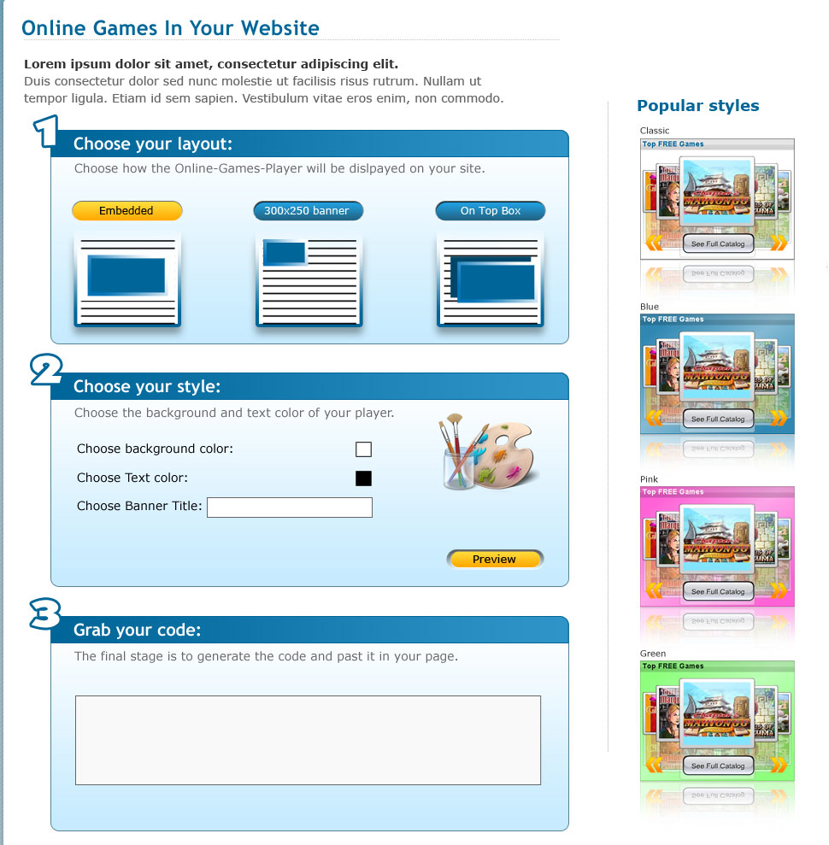
Widget Builder
Customize your Game Apps!
Choose a layout
Configure the style
Grab the embed code
Exent.com
14

Slide 15
Thanks for your time!
Concept Selection Process
Please send us a design concept that includes:
a. The core Widget Player. b. A 850X600 layout with Game catalog view. c. Dialog template within the player (e.g. “Share your score” dialog)
Exent.com
15

